Slide 1
Time series and forecasting:
Methods for Trend–Cycle Decomposition
From statistical filters to the “business cycle tracer”
Dr. Sebastiaan Tieleman
( StatNL, sb.tieleman@cbs.nl)
October 2026

Slide 2
Table of contents
Introduction
Decomposition model
What is a business cycle?
HP-filter
H-filter
Structural Time Series Model (STM)
Business cycle tracer
  Example
  Construction

Slide 3
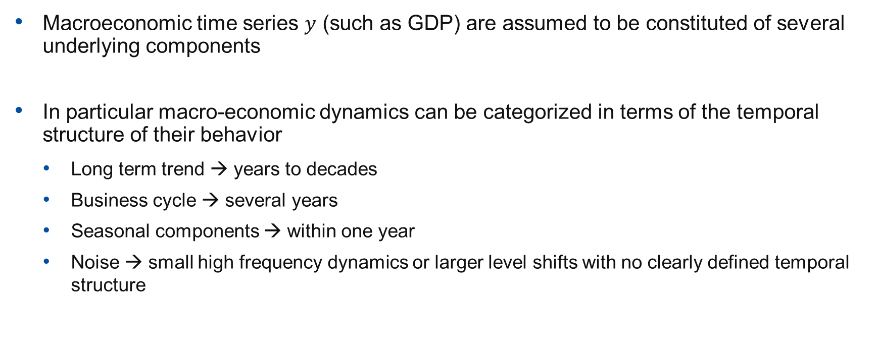
Introduction
Macroeconomic time series $y$ (such as GDP) are assumed to be constituted of several underlying components
In particular macro-economic dynamics can be categorized in terms of the temporal structure of their behavior
  Long term trend → years to decades
  Business cycle → several years
  Seasonal components → within one year
  Noise → small high frequency dynamics or larger level shifts with no clearly defined temporal structure

Slide 4
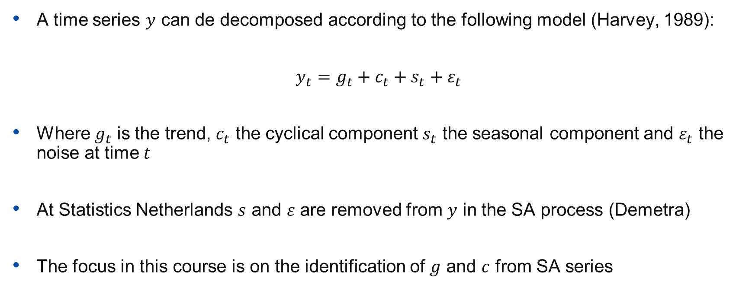
Decomposition model
A time series $y$ can de decomposed according to the following model (Harvey, 1989):
$$y_{t}={g_{t}+c}_{t}+s_{t}+ε_{t}$$
Where $g_{t}$ is the trend, $c_{t}$ the cyclical component $s_{t}$ the seasonal component and $ε_{t}$ the noise at time $t$
At Statistics Netherlands $s$ and $ε$ are removed from $y$ in the SA process (Demetra)
The focus in this course is on the identification of $g$ and $c$ from SA series

Slide 5
What is a business cycle?
“Business cycles are a type of fluctuation found in the aggregate economic activity of nations that organize their work mainly in business enterprises: a cycle consists of expansions occurring at about the same time in many economic activities, followed by similarly general recessions, contractions, and revivals which merge into the expansion phase of the next cycle; this sequence of changes is recurrent but not periodic; in duration business cycles vary from more than one year to ten or twelve years; they are not divisible into shorter cycles of similar character with amplitudes approximating their own.”
Burns & Mitchell (1946)
Importantly, the decomposition model is an (empirically informed) theoretical assumption about underlying structure of macroeconomic data
Some filters are better than others at detecting whether a business cycle exists

Slide 6
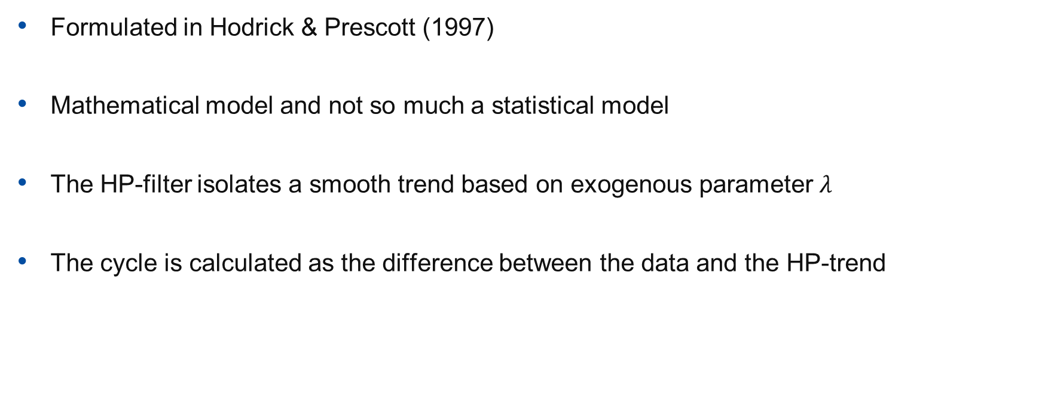
HP-filter - Introduction
Formulated in Hodrick & Prescott (1997)
Mathematical model and not so much a statistical model
The HP-filter isolates a smooth trend based on exogenous parameter $λ$
The cycle is calculated as the difference between the data and the HP-trend
Notes:
no explicit stochastic theory of how the data were generated, no likelihood function, no probability model for errors, no parameter estimation from sampling theory.

Slide 7
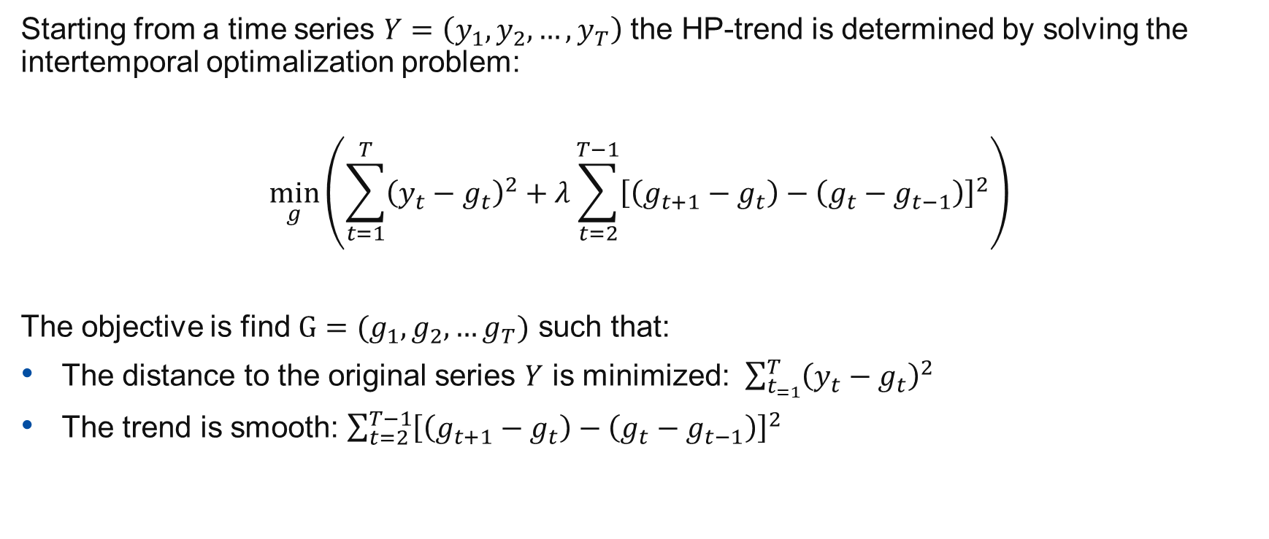
HP-filter – Optimization problem
Starting from a time series $Y=\left(y_{1}, y_{2},…,y_{T}\right)$ the HP-trend is determined by solving the intertemporal optimalization problem:
$$\min_{g}\left(\sum_{t=1}^{T}{{\left(y_{t}−g_{t}\right)}^{2}+λ\sum_{t=2}^{T−1}{{\left[\left(g_{t+1}−g_{t}\right)−\left(g_{t}−g_{t−1}\right)\right]}^{2}}}\right)$$
The objective is find $G=(g_{1},g_{2},…g_{T})$ such that:
The distance to the original series $Y$ is minimized: $\sum_{t_{=1}}^{T}{{\left(y_{t}−g_{t}\right)}^{2}}$
The trend is smooth: $\sum_{t=2}^{T−1}{{\left[\left(g_{t+1}−g_{t}\right)−\left(g_{t}−g_{t−1}\right)\right]}^{2}}$
Notes:
Note that the second component is equal to the second derivative of g, thus the change of the change (smoothness) should be minimized

Slide 8
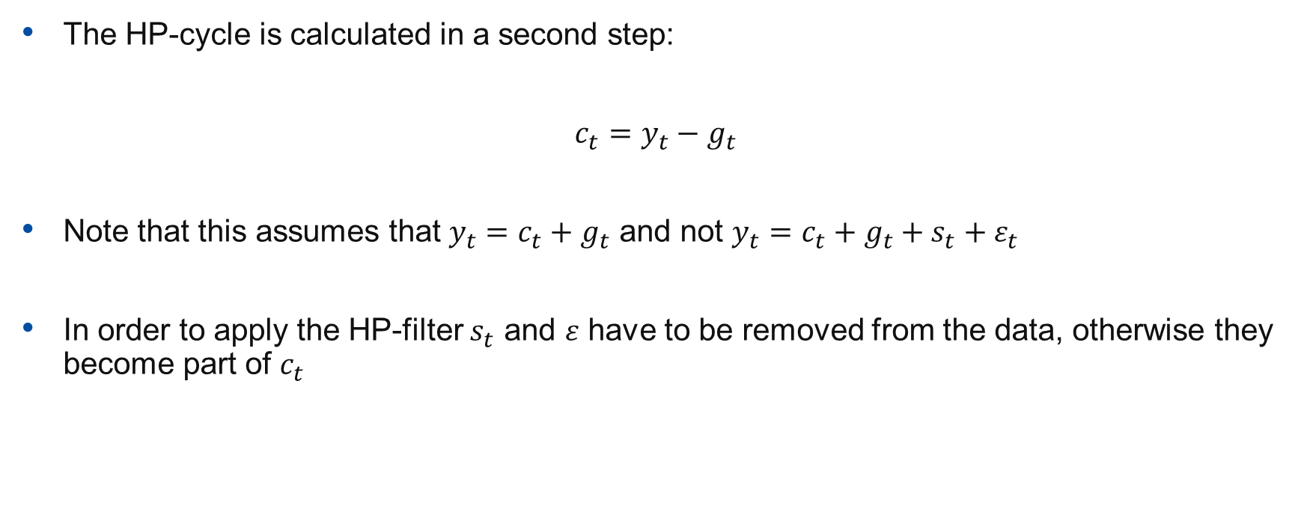
HP-filter - Cycle
The HP-cycle is calculated in a second step:
$$c_{t}=y_{t}−g_{t}$$
Note that this assumes that $y_{t}=c_{t}+g_{t}$ and not $y_{t}=c_{t}+g_{t}+s_{t}+ε_{t}$
In order to apply the HP-filter $s_{t}$ and $ε$ have to be removed from the data, otherwise they become part of $c_{t}$

Slide 9
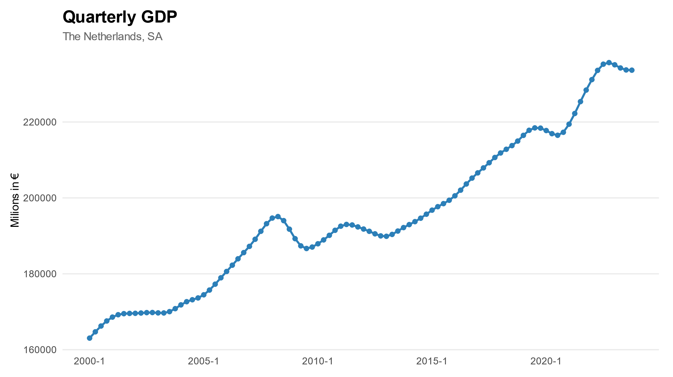
HP-filter - example

Slide 10
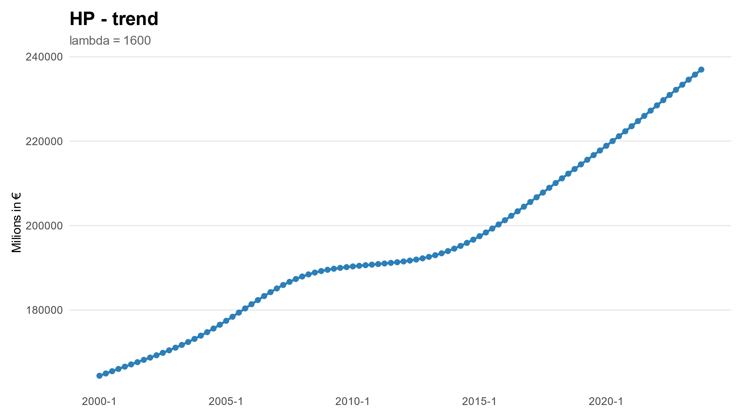
HP-filter - example

Slide 11
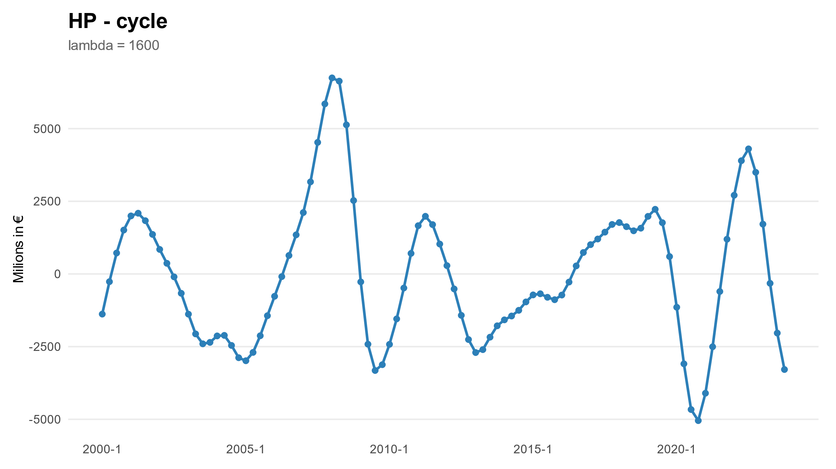
HP-filter - example

Slide 12
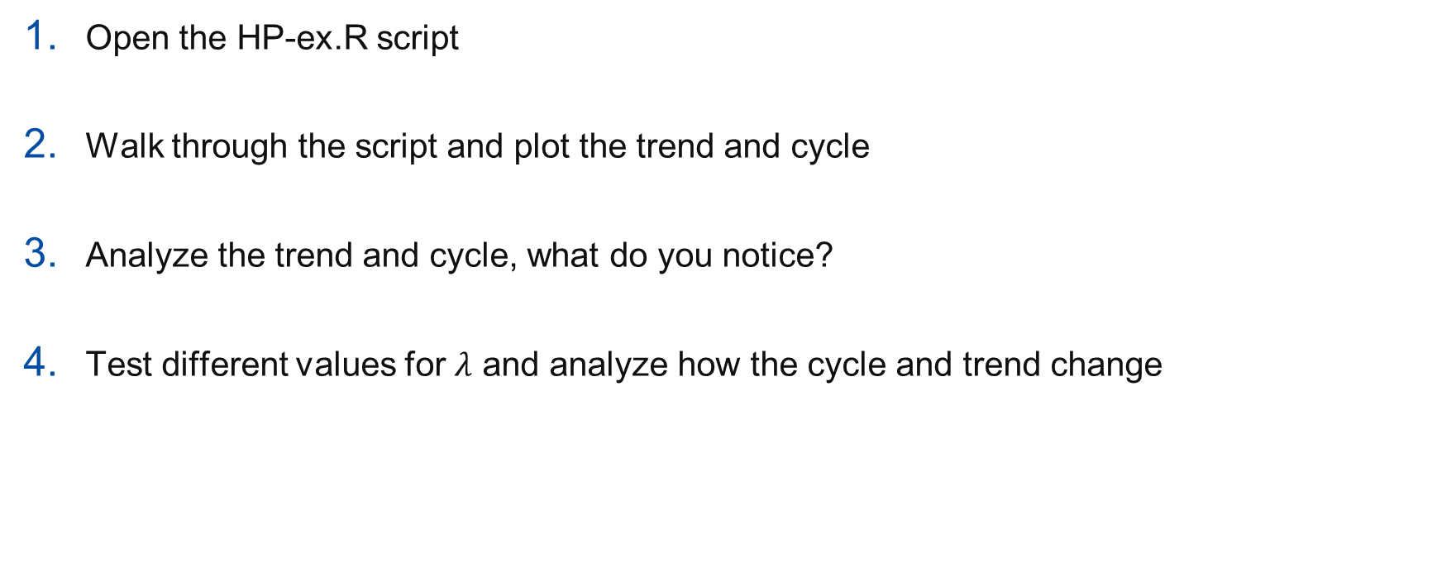
HP-filter -- exercise
Open the HP-ex.R script
Walk through the script and plot the trend and cycle
Analyze the trend and cycle, what do you notice?
Test different values for $λ$ and analyze how the cycle and trend change

Slide 13
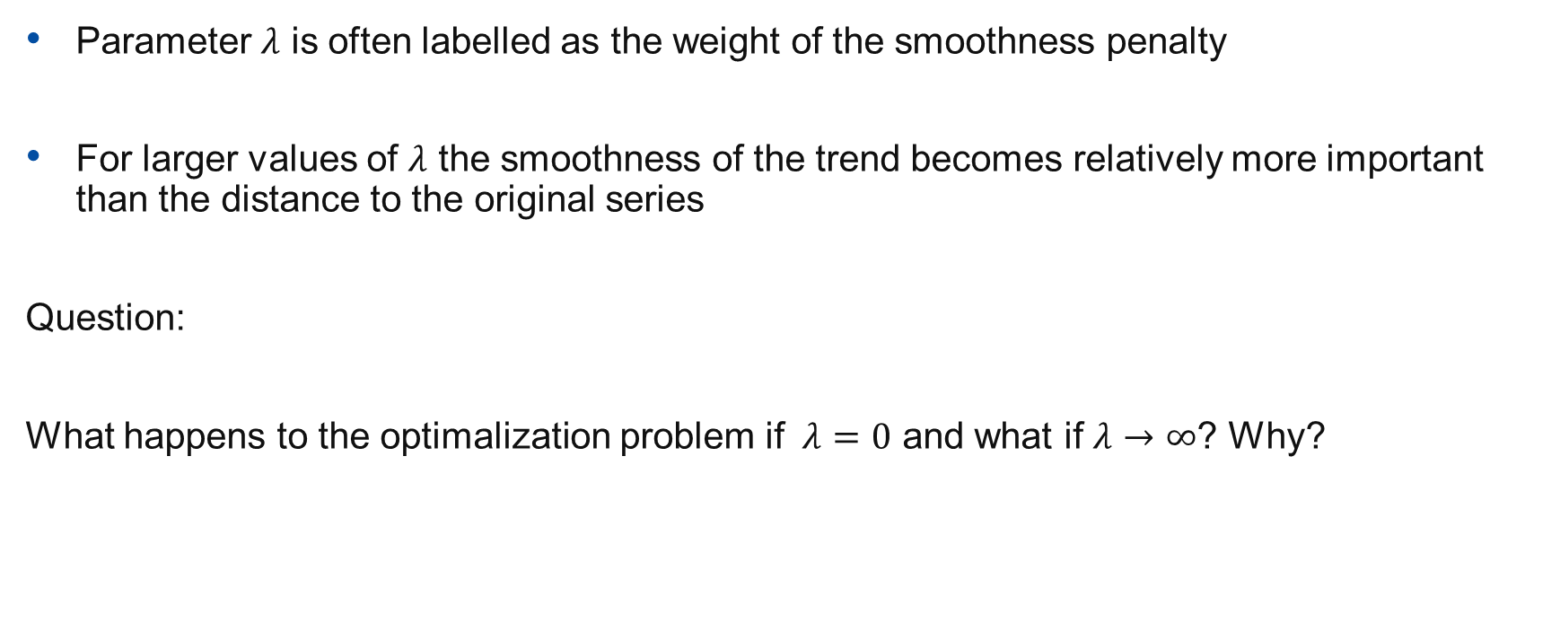

HP-filter - Parameter $λ$
Parameter $λ$ is often labelled as the weight of the smoothness penalty
For larger values of $λ$ the smoothness of the trend becomes relatively more important than the distance to the original series
Question:
What happens to the optimalization problem if $λ=0$ and what if $λ→∞$? Why?

Slide 14
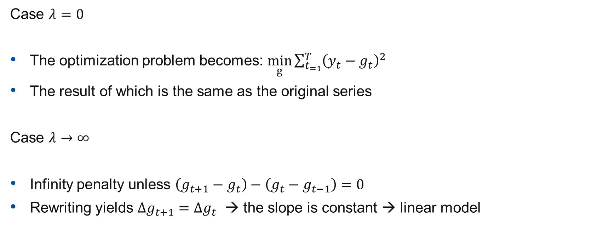

HP-filter – Parameter $λ$
Case $λ=0$
The optimization problem becomes: $\min_{g}\sum_{t_{=1}}^{T}{{\left(y_{t}−g_{t}\right)}^{2}}$
The result of which is the same as the original series
Case $λ→∞$
Infinity penalty unless $\left(g_{t+1}−g_{t}\right)−\left(g_{t}−g_{t−1}\right)=0$
Rewriting yields $Δg_{t+1}=Δg_{t}$ → the slope is constant → linear model

Slide 15
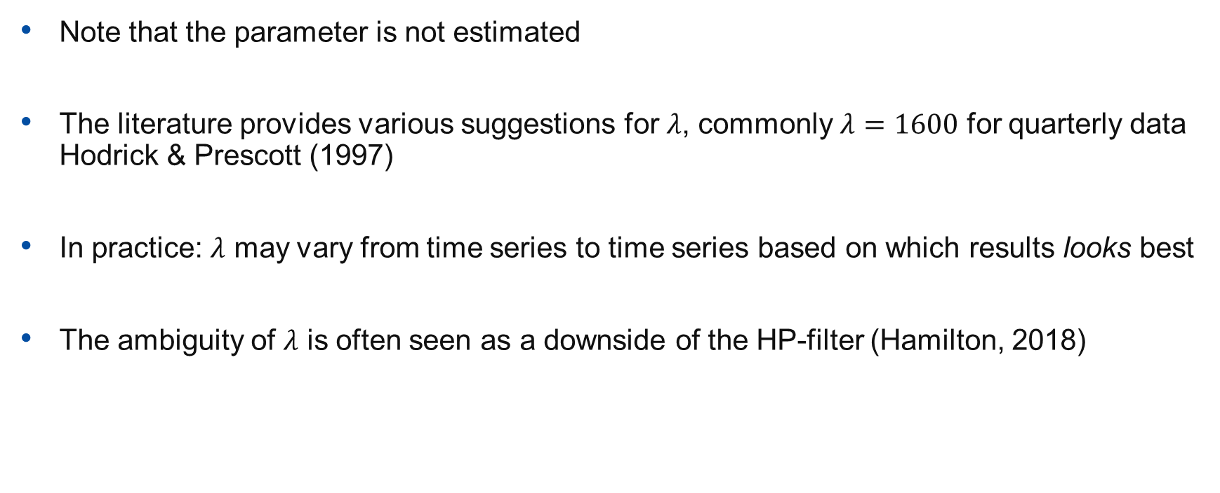
HP-filter – Parameter $λ$
Note that the parameter is not estimated
The literature provides various suggestions for $λ$, commonly $λ=1600$ for quarterly data Hodrick & Prescott (1997)
In practice: $λ$ may vary from time series to time series based on which results looks best
The ambiguity of $λ$ is often seen as a downside of the HP-filter (Hamilton, 2018)

Slide 16
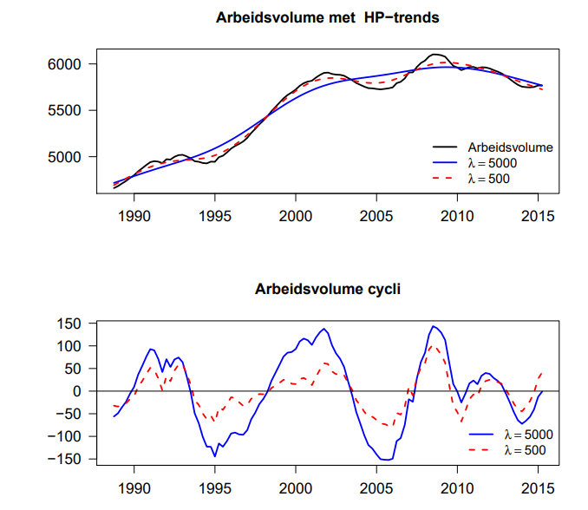
HP-filter – Parameter $λ$

Slide 17
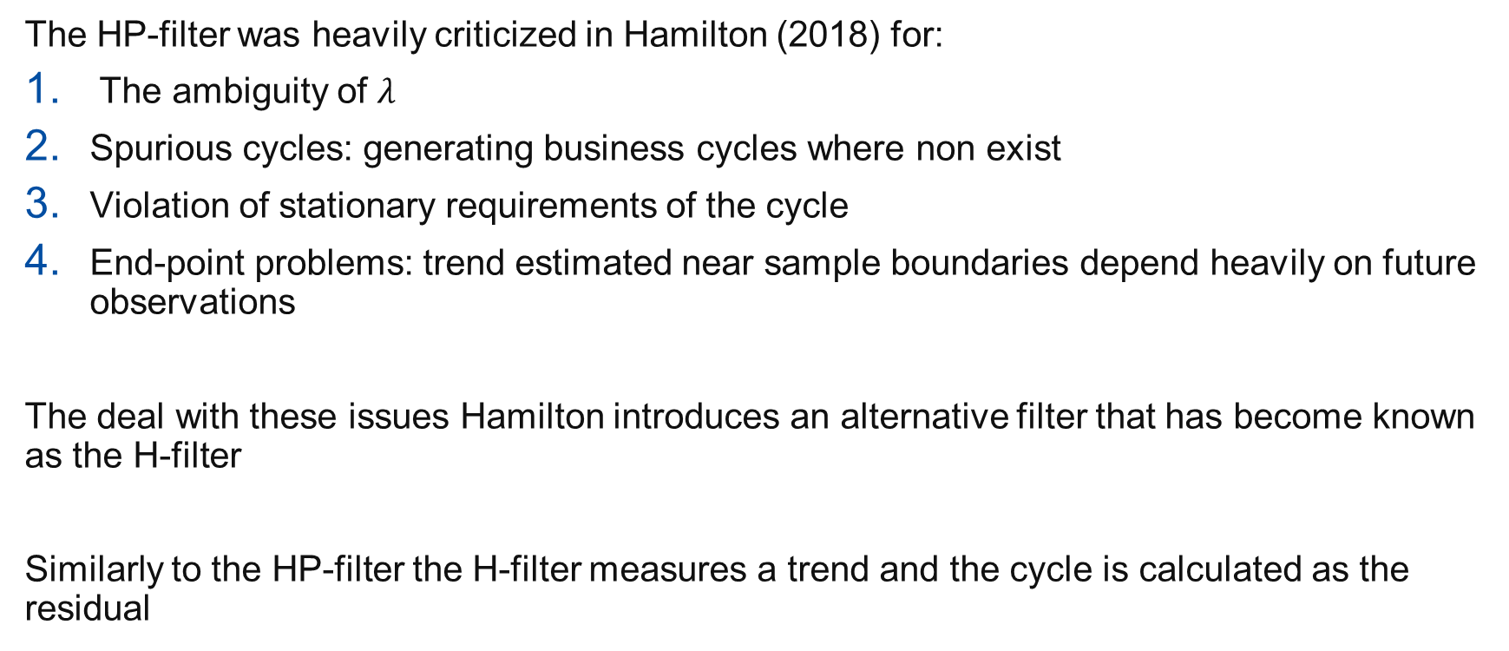
H-filter - Introduction
The HP-filter was heavily criticized in Hamilton (2018) for:
The ambiguity of $λ$
Spurious cycles: generating business cycles where non exist
Violation of stationary requirements of the cycle
End-point problems: trend estimated near sample boundaries depend heavily on future observations
The deal with these issues Hamilton introduces an alternative filter that has become known as the H-filter
Similarly to the HP-filter the H-filter measures a trend and the cycle is calculated as the residual

Slide 18
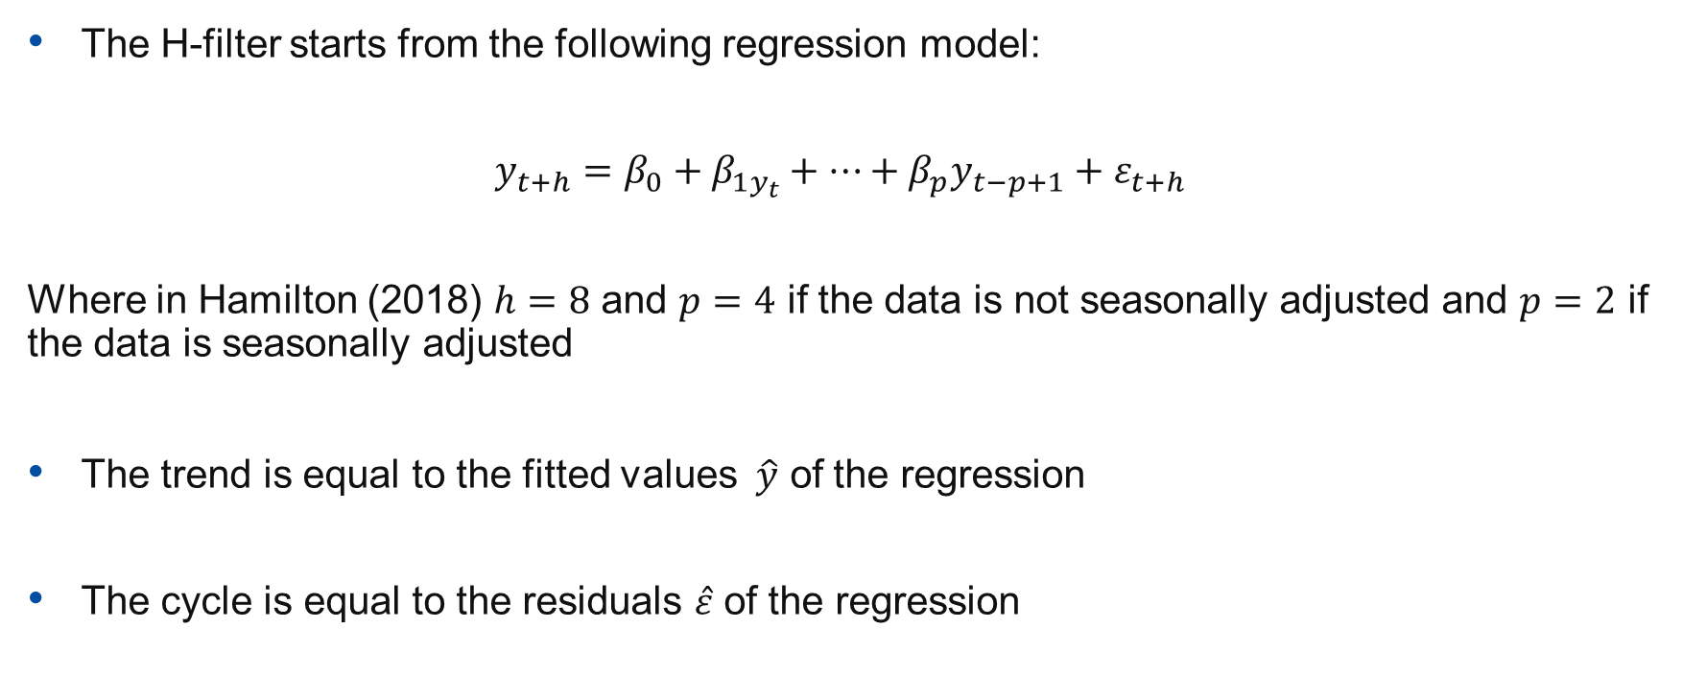
H-filter - Model
The H-filter starts from the following regression model:
$$y_{t+h}=β_{0}+β_{1y_{t}}+…+β_{p}y_{t−p+1}+ε_{t+h}$$
Where in Hamilton (2018) $h=8$ and $p=4$ if the data is not seasonally adjusted and $p=2$ if the data is seasonally adjusted
The trend is equal to the fitted values $\hat{y}$ of the regression
The cycle is equal to the residuals $\hat{ε}$ of the regression

Slide 19
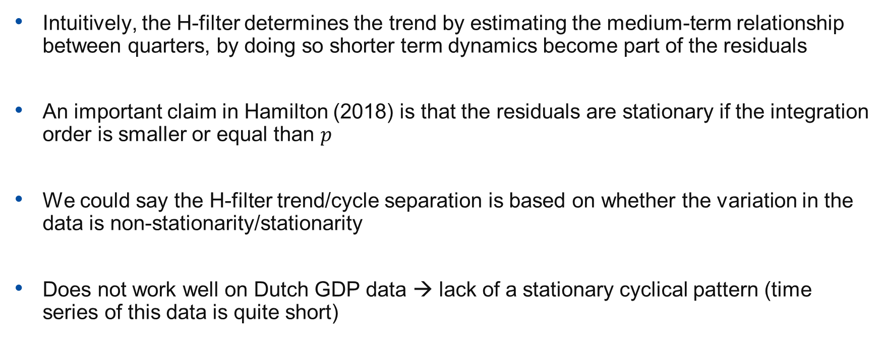
H-filter - Explanation
Intuitively, the H-filter determines the trend by estimating the medium-term relationship between quarters, by doing so shorter term dynamics become part of the residuals
An important claim in Hamilton (2018) is that the residuals are stationary if the integration order is smaller or equal than $p$
We could say the H-filter trend/cycle separation is based on whether the variation in the data is non-stationarity/stationarity
Does not work well on Dutch GDP data → lack of a stationary cyclical pattern (time series of this data is quite short)

Slide 20
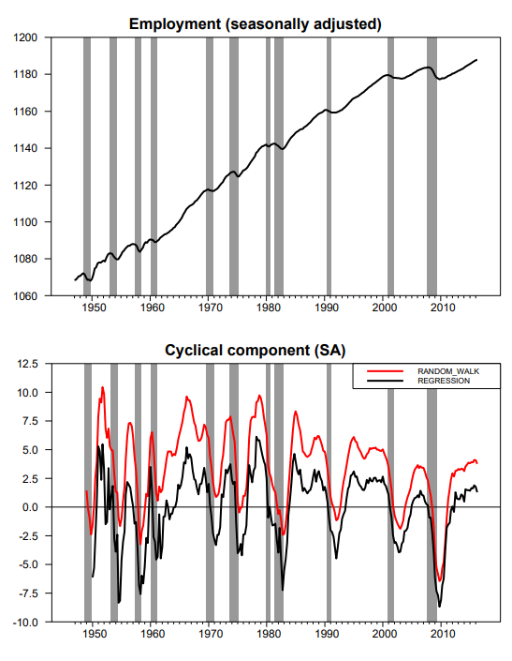
H-filter - example

Slide 21
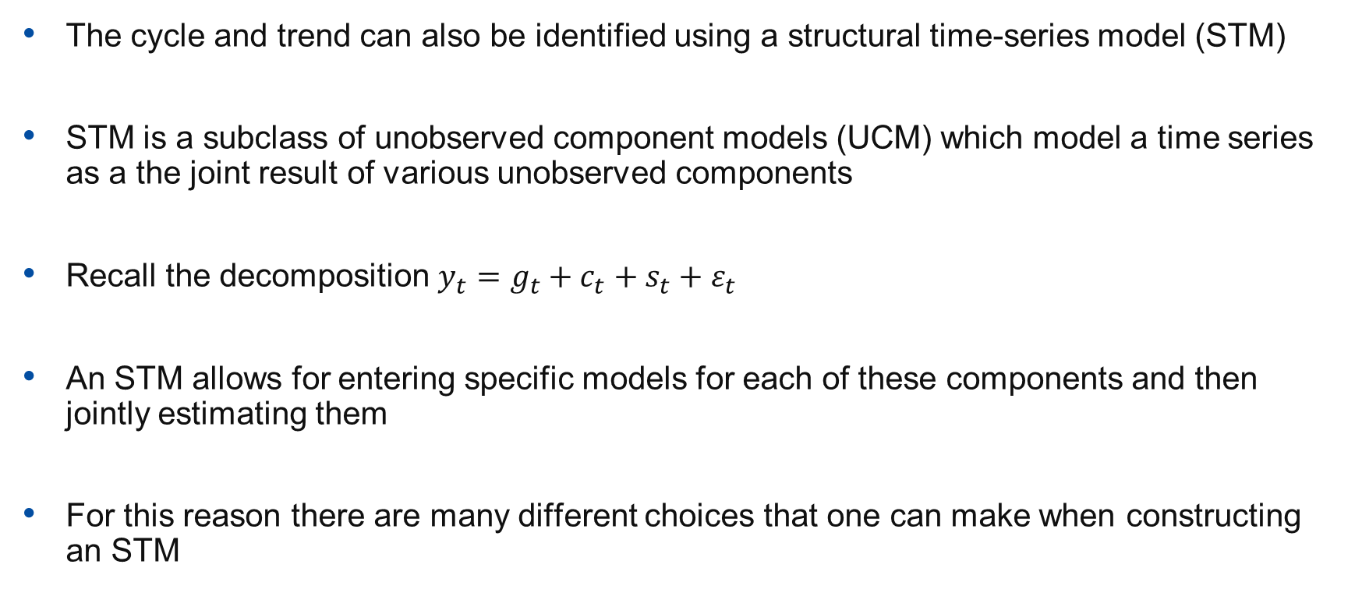
STM - Introduction
The cycle and trend can also be identified using a structural time-series model (STM)
STM is a subclass of unobserved component models (UCM) which model a time series as a the joint result of various unobserved components
Recall the decomposition $y_{t}=g_{t}+c_{t}+s_{t}+ε_{t}$
An STM allows for entering specific models for each of these components and then jointly estimating them
For this reason there are many different choices that one can make when constructing an STM

Slide 22
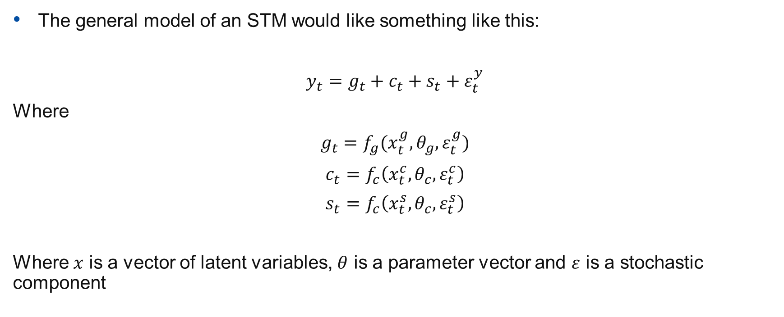
STM – General model
The general model of an STM would like something like this:
$$y_{t}=g_{t}+c_{t}+s_{t}+ε_{t}^{y}$$
Where
$$g_{t}=f_{g}(x_{t}^{g},θ_{g},ε_{t}^{g})$$
$$c_{t}=f_{c}\left(x_{t}^{c},θ_{c},ε_{t}^{c}\right)$$
$$s_{t}=f_{c}\left(x_{t}^{s},θ_{c},ε_{t}^{s}\right)$$
Where $x$ is a vector of latent variables, $θ$ is a parameter vector and $ε$ is a stochastic component

Slide 23
STM – Estimation
STMs are estimated by moving through the following steps:
Specify state space model
Initialize states
Run Kalman filter
Build likelihood for forecast errors
Maximum likelihood estimation of parameters
Run Kalman smoother

Slide 24
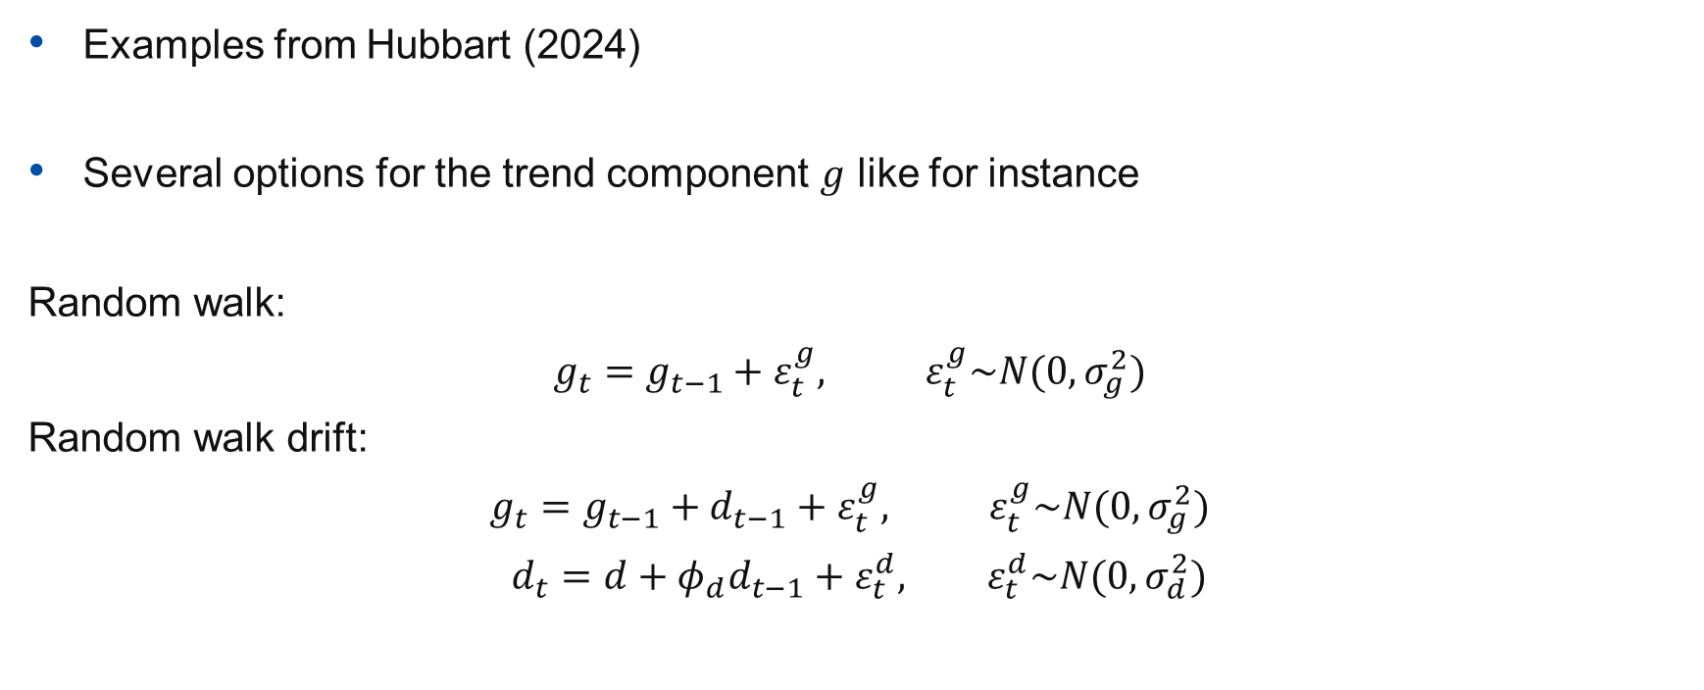
STM – Example model trend
Examples from Hubbart (2024)
Several options for the trend component $g$ like for instance
Random walk:
$$g_{t}=g_{t−1}+ε_{t}^{g}, ε_{t}^{g}\sim N(0,σ_{g}^{2})$$
Random walk drift:
$$g_{t}=g_{t−1}+d_{t−1}+ε_{t}^{g}, ε_{t}^{g}\sim N(0,σ_{g}^{2})$$
$$d_{t}=d+φ_{d}d_{t−1}+ε_{t}^{d}, ε_{t}^{d}\sim N(0,σ_{d}^{2})$$

Slide 25
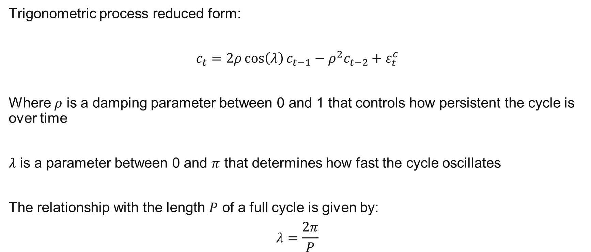
STM – Example model cycle
Trigonometric process reduced form:
$$c_{t}=2ρ\cos\left(λ\right)c_{t−1}−ρ^{2}c_{t−2}+ε_{t}^{c}$$
Where $ρ$ is a damping parameter between 0 and 1 that controls how persistent the cycle is over time
$λ$ is a parameter between 0 and $π$ that determines how fast the cycle oscillates
The relationship with the length $P$ of a full cycle is given by:
$$λ=\frac{2π}{P}$$

Slide 26
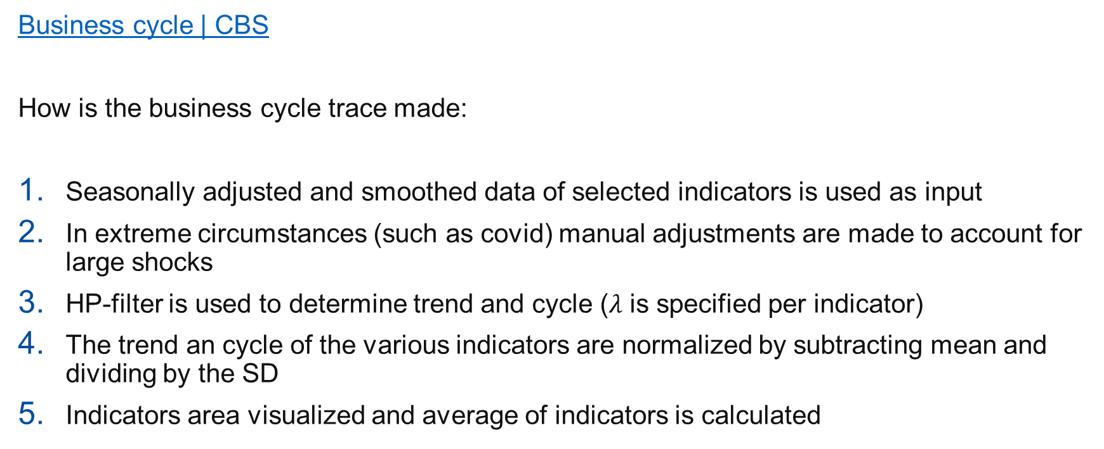
Business cycle tracer
Business cycle | CBS
How is the business cycle trace made:
Seasonally adjusted and smoothed data of selected indicators is used as input
In extreme circumstances (such as covid) manual adjustments are made to account for large shocks
HP-filter is used to determine trend and cycle ($λ$ is specified per indicator)
The trend an cycle of the various indicators are normalized by subtracting mean and dividing by the SD
Indicators area visualized and average of indicators is calculated

Slide 27
Business cycle tracer – Discussion
Make group of 2 or 3 and discuss the following questions:
Do you think a business cycle tracer is a good tool to determine the state of the economy?
What are potential downsides from using the business cycle tracer?
What would be good criteria for indicator selection?
What do you think of the choice for the HP-filter?

Slide 28
References
Harvey, A. C. (1989). Forecasting, structural time series models and the Kalman filter. Cambridge University Press.
Burns, A. F., & Mitchell, W. C. (1946). Measuring business cycles. National Bureau of Economic Research.
Hodrick, R. J., & Prescott, E. C. (1997). Postwar U.S. business cycles: An empirical investigation. Journal of Money, Credit and Banking, 29(1), 1–16.
Hamilton, J. D. (2018). Why you should never use the Hodrick-Prescott filter. The Review of Economics and Statistics, 100(5), 831–843.
Mohr, M. F. (2005). A trend-cycle(-season) filter. European Central Bank Working Paper Series No. 499.
Hubbard, A. (2024). AutoSTSM vignette: Automatic structural time series modelling in R. CRAN.

